Slide 2
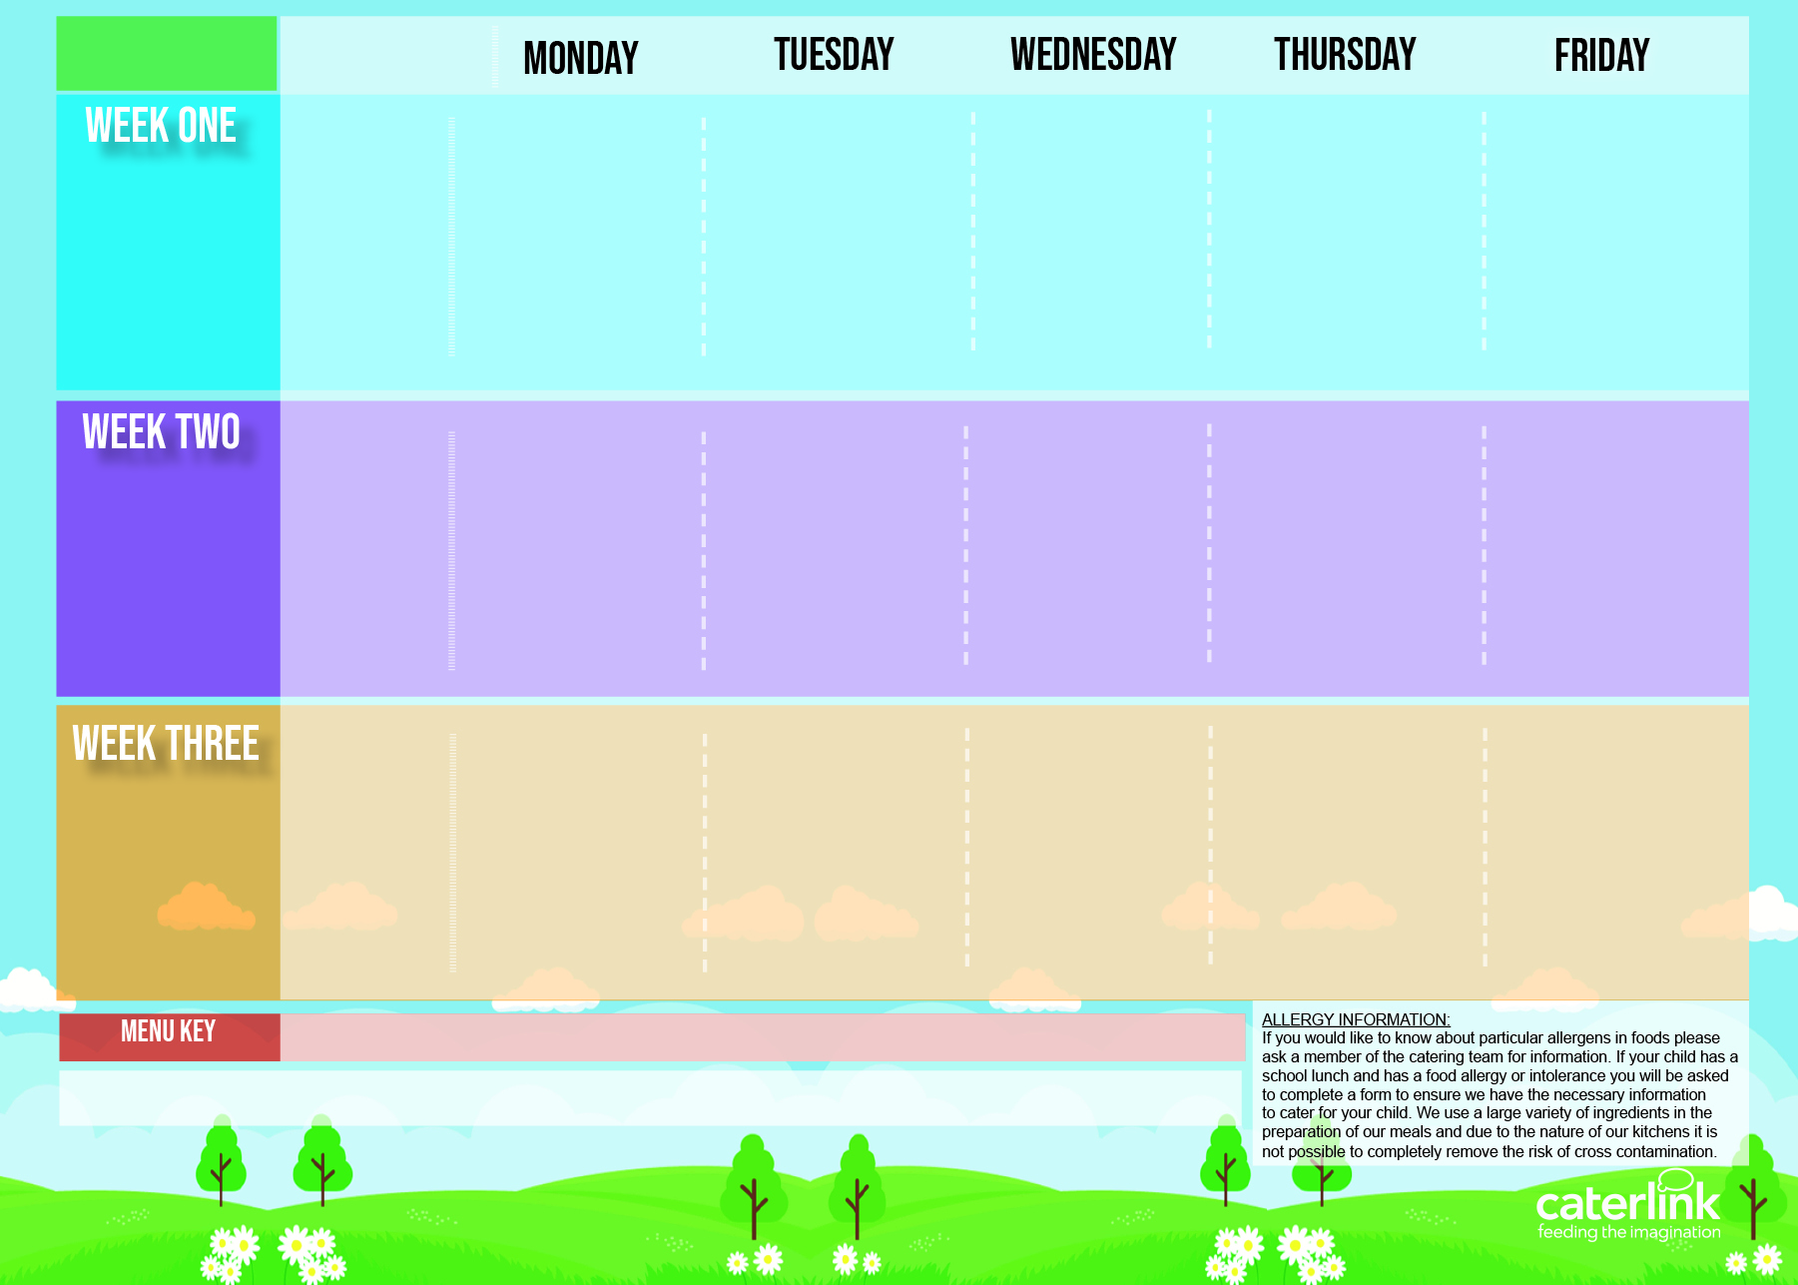
Spring Summer 2024 3 Choice JKT
Option One
Deep Pan Cheese and tomato Pizza with Salad Bar
Penne Bolognaise with Garlic bread
Sausages with Roast Potatoes and Gravy
Greek Chicken Pitta with Rice Tzatziki and salads
Fish Fingers and Chips with tomato Sauce
15/04/2024
06/05/2024
03/06/2024
24/06/2024
15/07/2024
02/09/2024
23/09/2024
14/10/2024
Option Two
Vegetable Stack with Rice
Vegan Bolognaise with Garlic bread
Vegan Sausages with Roast Potatoes and gravy
Cheese Whirl with Rice and salads
Mexican bean roll with Chips and Tomato sauce
Option Three
Jacket potato with Cheese, Beans or Tuna
Jacket potato with Cheese, Beans or Tuna
Tomato Pasta
Jacket potato with Cheese, Beans or Tuna
Tomato Pasta
Vegetables
Vegetables of the day
Vegetables of the day
Vegetables of the day
Vegetables of the day
Vegetables of the day
Dessert
Apple Crumble and cream
Vanilla Sponge
NEW Strawberry Mousse
Mandarin Cake
Vanilla Shortbread
Option One
Deep Pan Cheese and tomato Pizza with Salad Bar
Beef Burger in a roll with Potato Wedges
Roast Chicken Stuffing Roast potatoes and Gravy
Mac and cheese with Chicken topping and salad
Fish Fingers and Chips with tomato Sauce
22/04/2024
13/05/2024
10/06/2024
01/07/2024
22/07/2024
09/09/2024
30/09/2024
21/10/2024
Option Two
Vegan Burger in a roll with Potato wedges
Vegetable Wellington with roast Potatoes & stuffing
Mac and cheese with roasted vegetable topping
Vegetable Curry with Rice
Vegan Sausage Roll with Chips and Tomato Sauce
Option Three
Jacket potato with Cheese Beans or Tuna
Jacket potato with Cheese Beans or Tuna
Tomato Pasta
Jacket potato with Cheese Beans or Tuna
Tomato Pasta
Vegetables
Vegetables of the day
Vegetables of the day
Vegetables of the day
Vegetables of the day
Vegetables of the day
Dessert
Chocolate Brownie
NEW Iced Biscuit
Jelly and mandarins
Peach Upside down cake
Oaty Cookie
Option One
Deep Pan Cheese and tomato Pizza with Salad Bar
Sausage Pasta Bake
Roast Turkey Roast Potatoes and Gravy
Chicken Paella with potato bravas
Fish Fingers and Chips with tomato Sauce
29/04/2024
20/05/2024
17/06/2024
08/07/2024
16/09/2024
07/10/2024
Option Two
All Day Vegetarian Breakfast
Vegetable Pasta Bake
Parsnip and sweet potato Loaf with Roast Potatoes and Gravy
Veggie meatballs with potato bravas
Cheese and Bean Pasty with Chips and tomato sauce
Option Three
Jacket potato with Cheese Beans or Tuna
Jacket potato with Cheese Beans or Tuna
Tomato Pasta
Jacket potato with Cheese Beans or Tuna
Tomato Pasta
Vegetables
Vegetables of the day
Vegetables of the day
Vegetables of the day
Vegetables of the day
Vegetables of the day
Dessert
Chocolate and Pear Sponge
Syrup Snap Biscuit
Eves Pudding and Cream
Chocolate Shortbread
Summer Lemon Cake
Added Plant Power
Wholemeal
Vegan
Chef’s Special
Available Daily: - Bread freshly baked on site daily- Daily salad selection

