Slide 1
USE LESS STUFF!!!
By Louie. C and Georgia D

Slide 2
A graph of what one group found on the beach

Slide 3
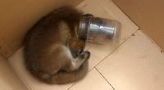
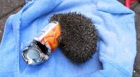
What litter does to our wild life?
The RSPCA receive over 7,000 phone calls a year about litter-related incidents and our officers regularly rescue animals trapped or hurt by litter.
1.9 billion tons of litter ends up in the sea every year

Slide 4
What litter does to our world?
£11.5 billion pounds is spent every year to clean up litter
50% of littered items are cigarette butts
There are nearly 2,000 items of rubbish for every kilometre on a beach
Plastic litter on beaches has
increased 140% since 1994

Slide 5
Motorists generate 52% of litter along roadways and highways
On average there are 51 billion pieces of
litter found on roadways, that’s 6,729 items along per mile of roadway

Slide 6
Decomposition Times
How long it takes to biodegrade
Glass bottle | Approx. 1 million years
Plastic 6-pack cover | 450 years
Aluminum can | 200-500 years
Rubber boot sole | 50-80 years
Leather | up to 50 years
Nylon fabric | 30-40 years
Plastic film container | 20-30 years
Painted wooden stake | 13 years
Plastic bag | 10-20 years
Plastic coated paper | 5 years
Wool clothing | 1-5 years
Cigarette butt | 1-5 years
Cotton rag | 1-5 months
Orange peel or banana peel | 2-5 weeks

